Slide 1
IP SOFT Phone Training program
Technology

Slide 2
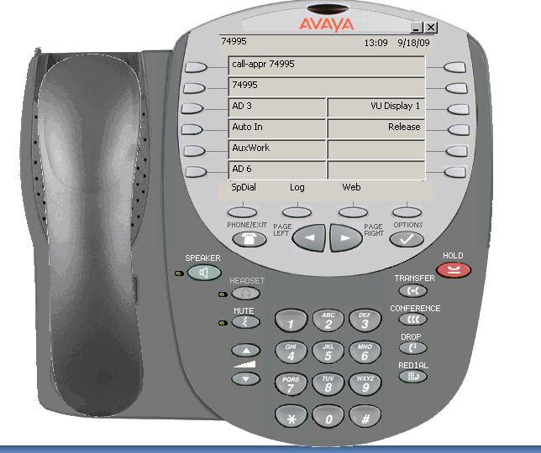
Soft Phone

Slide 3
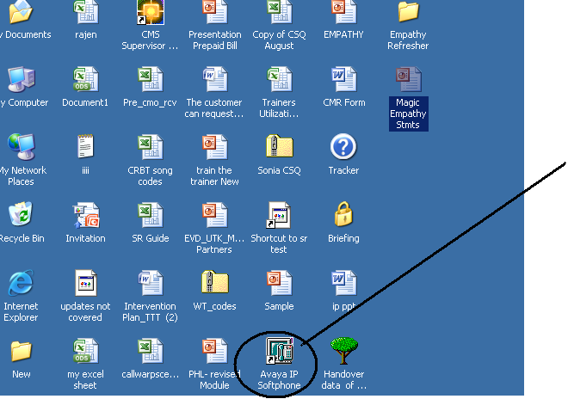
Click on Avaya IP Soft phone

Slide 4
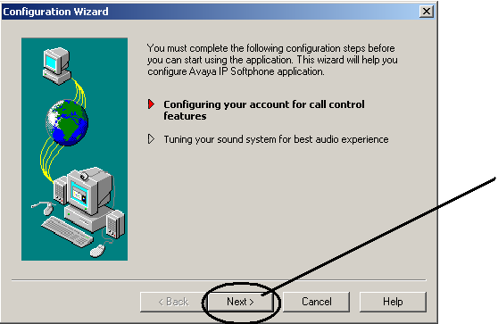
Click on Next button

Slide 5
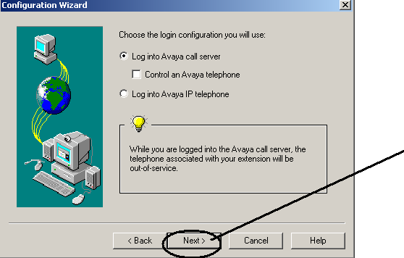
Click on Next button

Slide 6
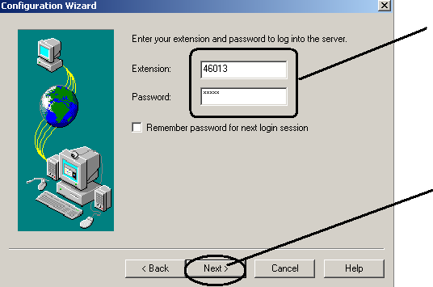
Enter Extension Number & Password
Click on Next Button

Slide 7
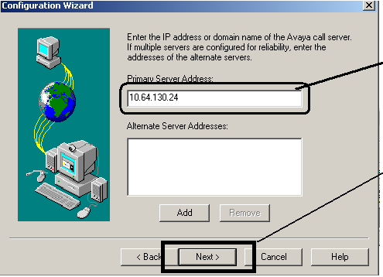
Enter Primary Server Address “10.64.130.24” & Click on Next Button

Slide 8
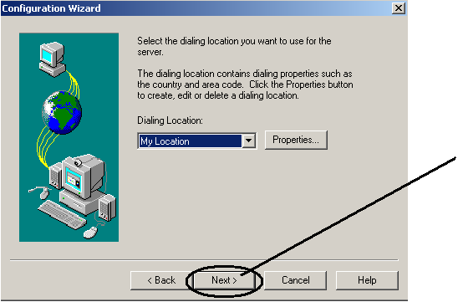
Select My Location and click on next button

Slide 9
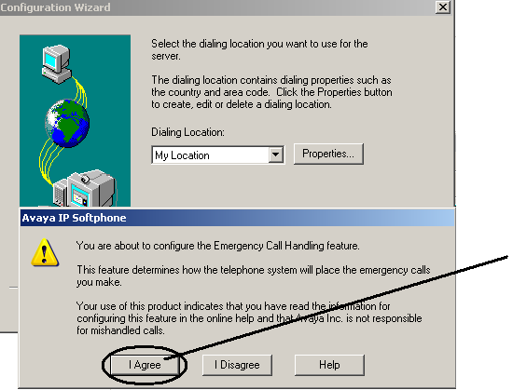
Click on Next Button

Slide 10
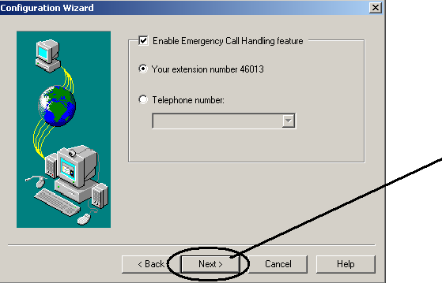
Click on Next Button

Slide 11
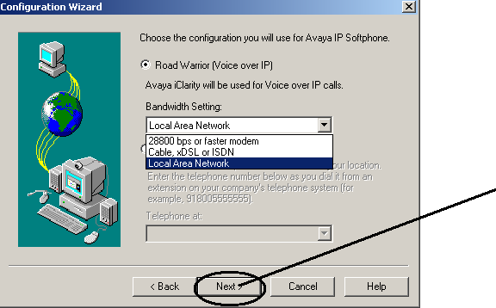
Select Local Area Network and click on next button

Slide 12
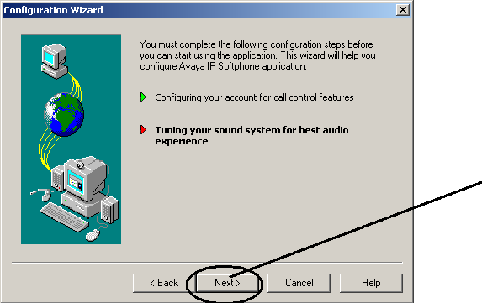
Click on Next button

Slide 13
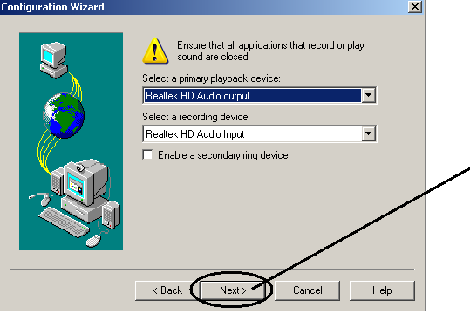
Click on Next button

Slide 14
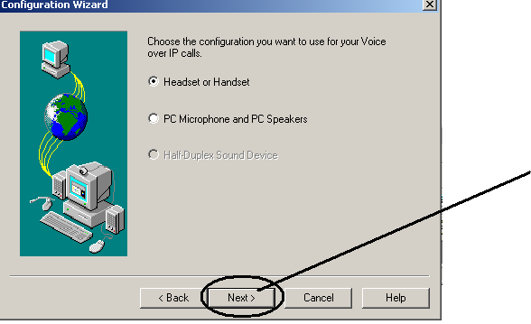
Select Headset to Handset and click on next button

Slide 15
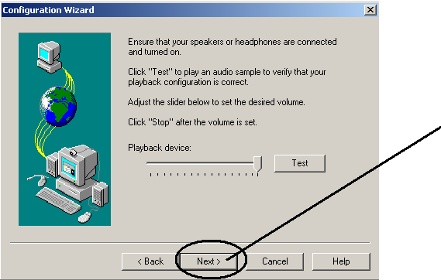
Click on Next button

Slide 16
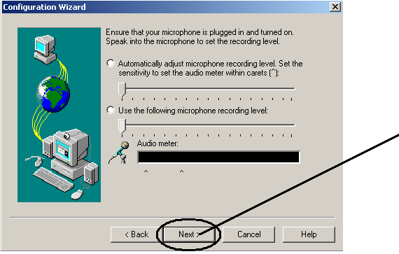
Click on Next button

Slide 17
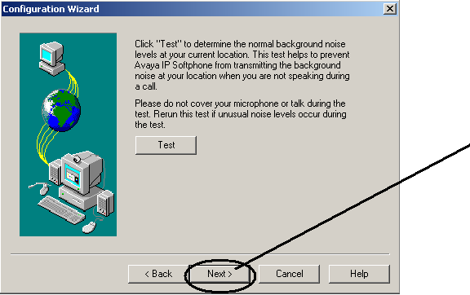
Click on Next button

Slide 18
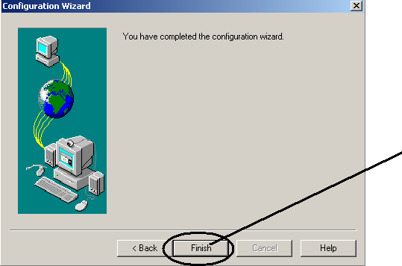
Click on Finish button

Slide 19
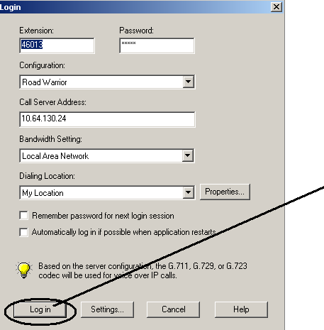
Click on Login button

Slide 20
Agent Log-In
Pressing the login button then followed by*055+ Agent ID + Password ( 6 digit ).

Slide 21
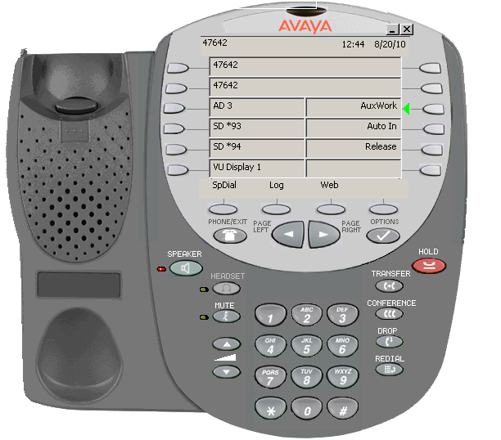
1.Dial your 6 digit unique Login -ID.
2. Dial your 6 digit password the default
password is Eg:“123456”,wait for confirmation tone .The display will show
Number of skill on agent ID.
3. AUX Mode would be automatically
selected ,Press ‘Auto-In key to change
your state to “Available”

Slide 22
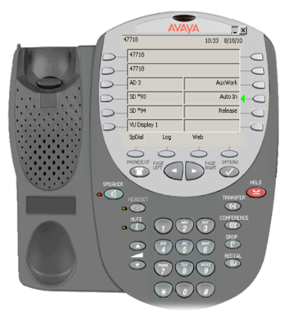

Slide 23
Thanks
Helpdesk Jamshedpur

